Slide 1
Instructions
Duplicate template
Replace title and lines
Resize line under title – should be 0.3” height
Resize lines (18 or 16 font) and align text box to bottom of line
Add picture and send to back
Lower the picture where you want it
Crop the top

Slide 2

Title
Line 1 Line 2 Line 3

Slide 3
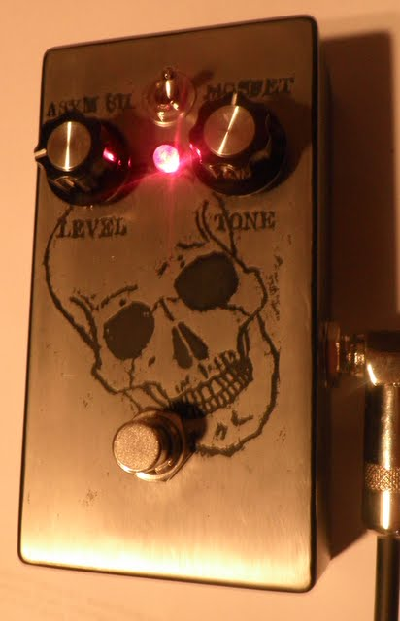
Modified Bazz Fuss
My version of the Bazz Fuss circuit
with switchable clipping diodes
and a BMP tone control

Slide 4
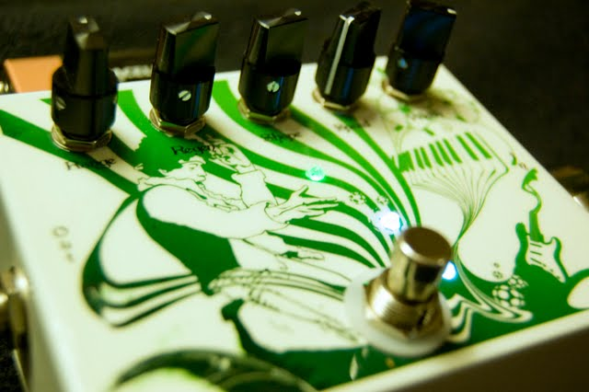
Causality 4 Phaser
A 4-stage phaser with regen
designed by frequencycentral

Slide 5
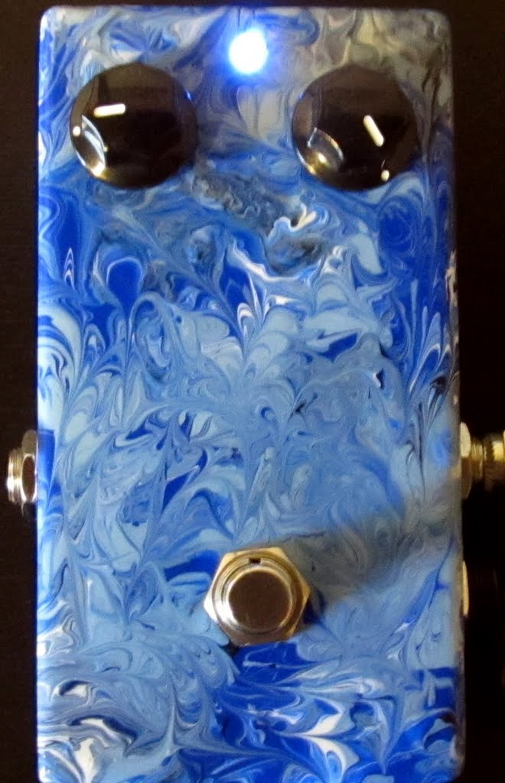
BYOC Fuzz
A clone of a germanium Fuzz Face
and the first pedal I ever made

Slide 6
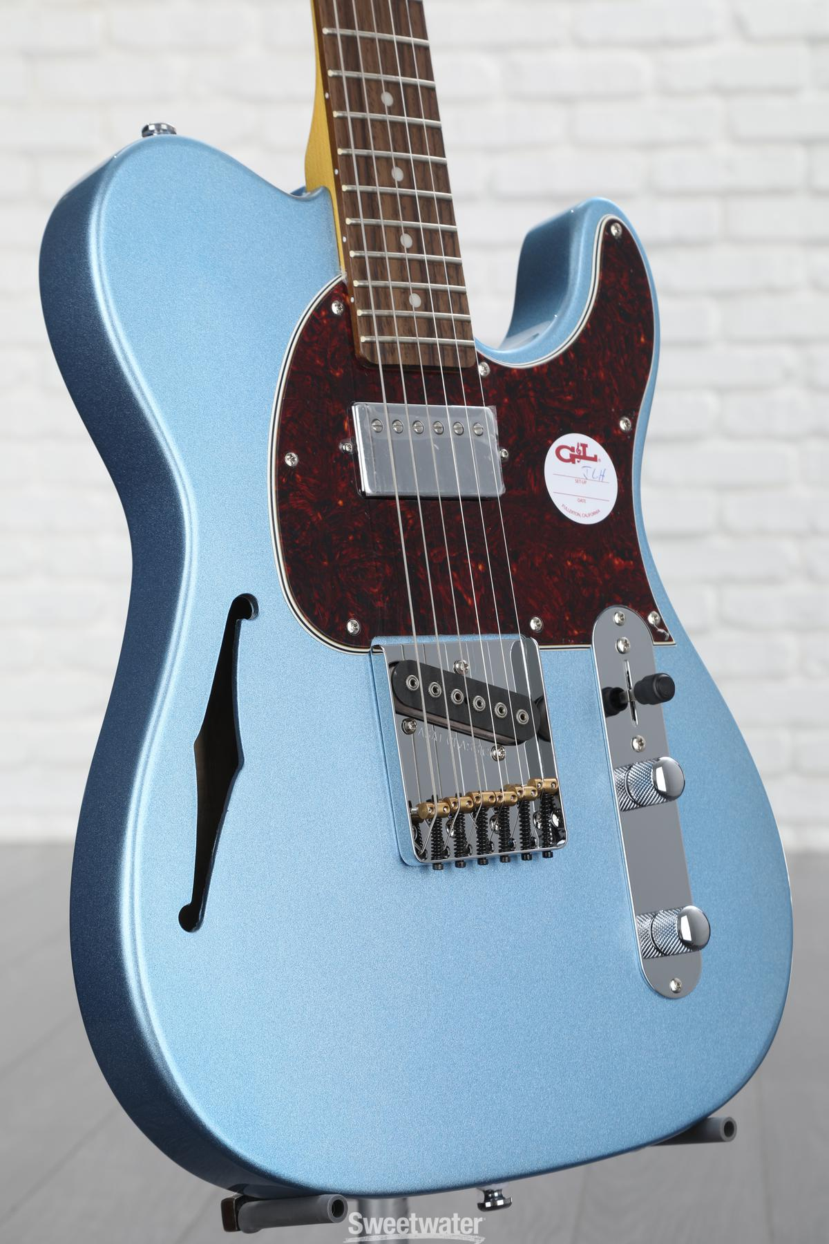
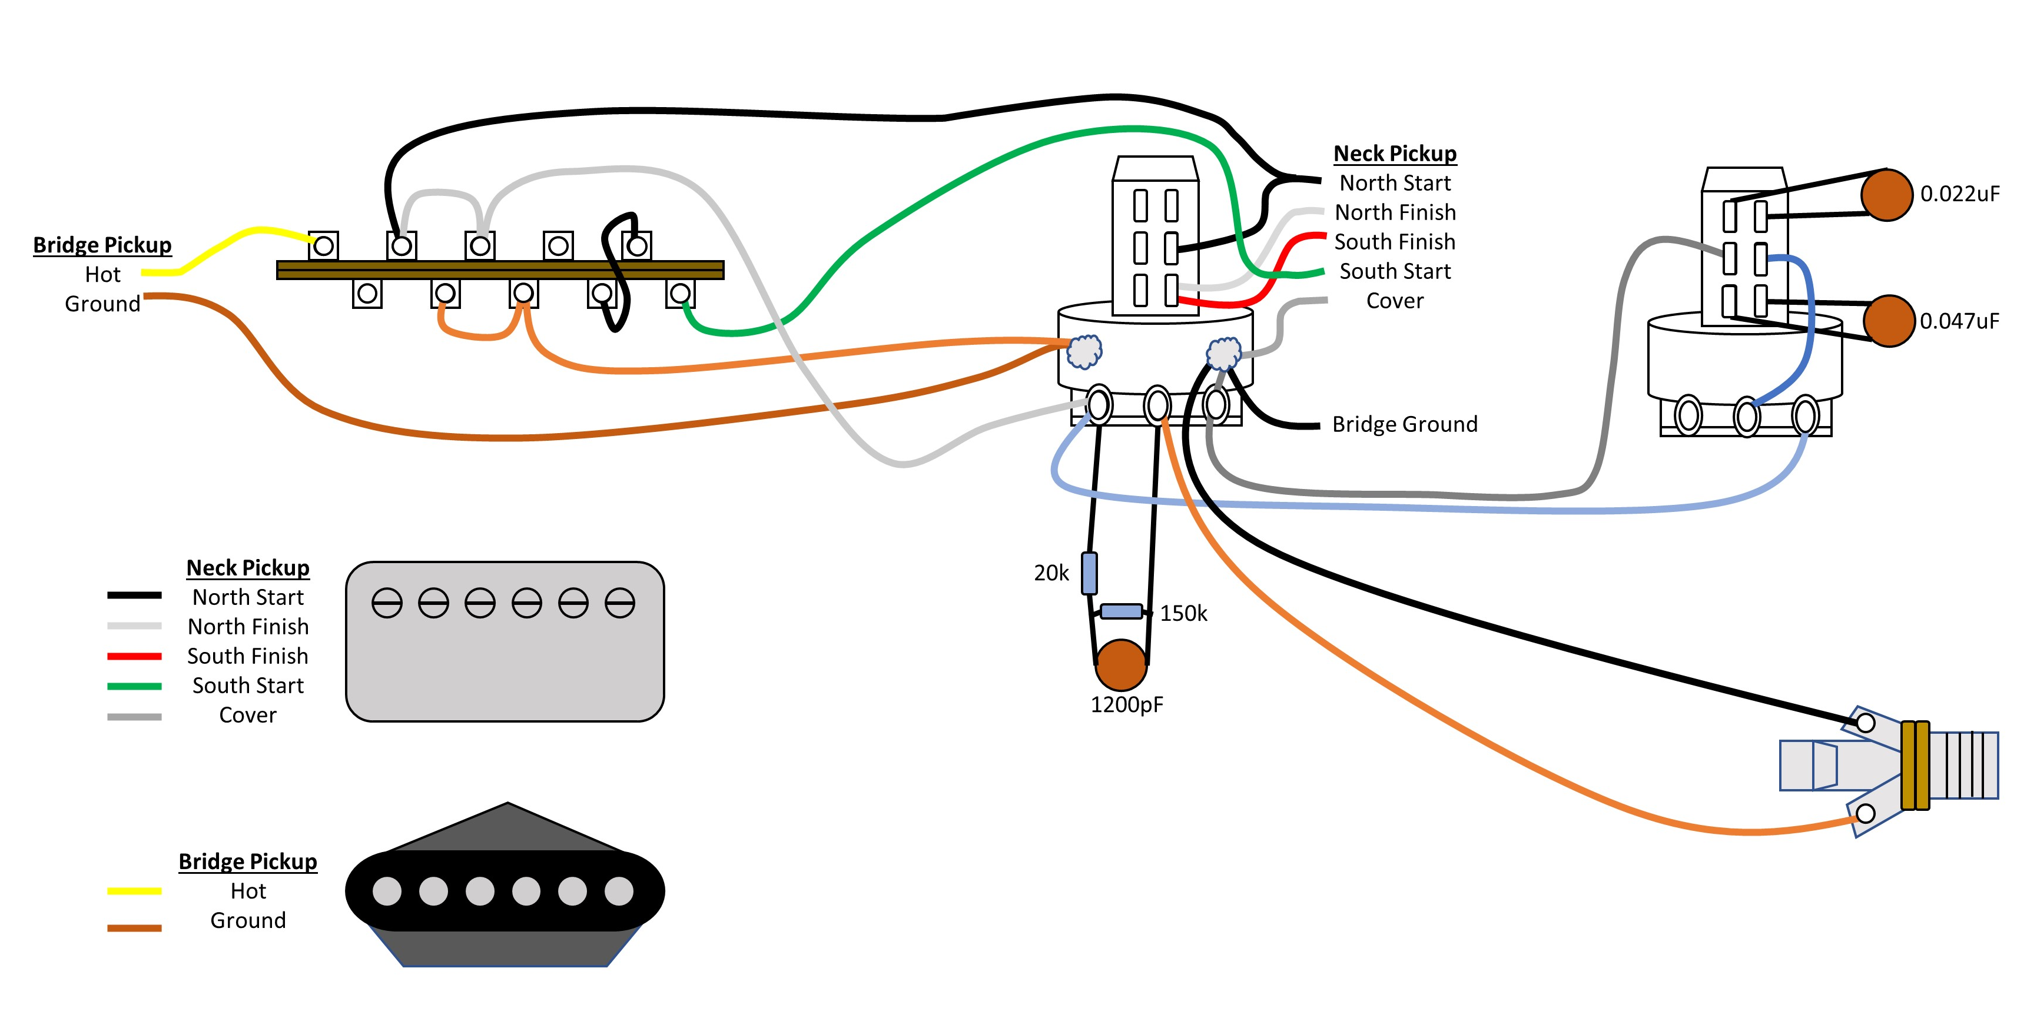
ASAT Guitar Rewire
My work rewiring and
improving the controls on a
G&L ASAT Classic Tribute

Slide 7
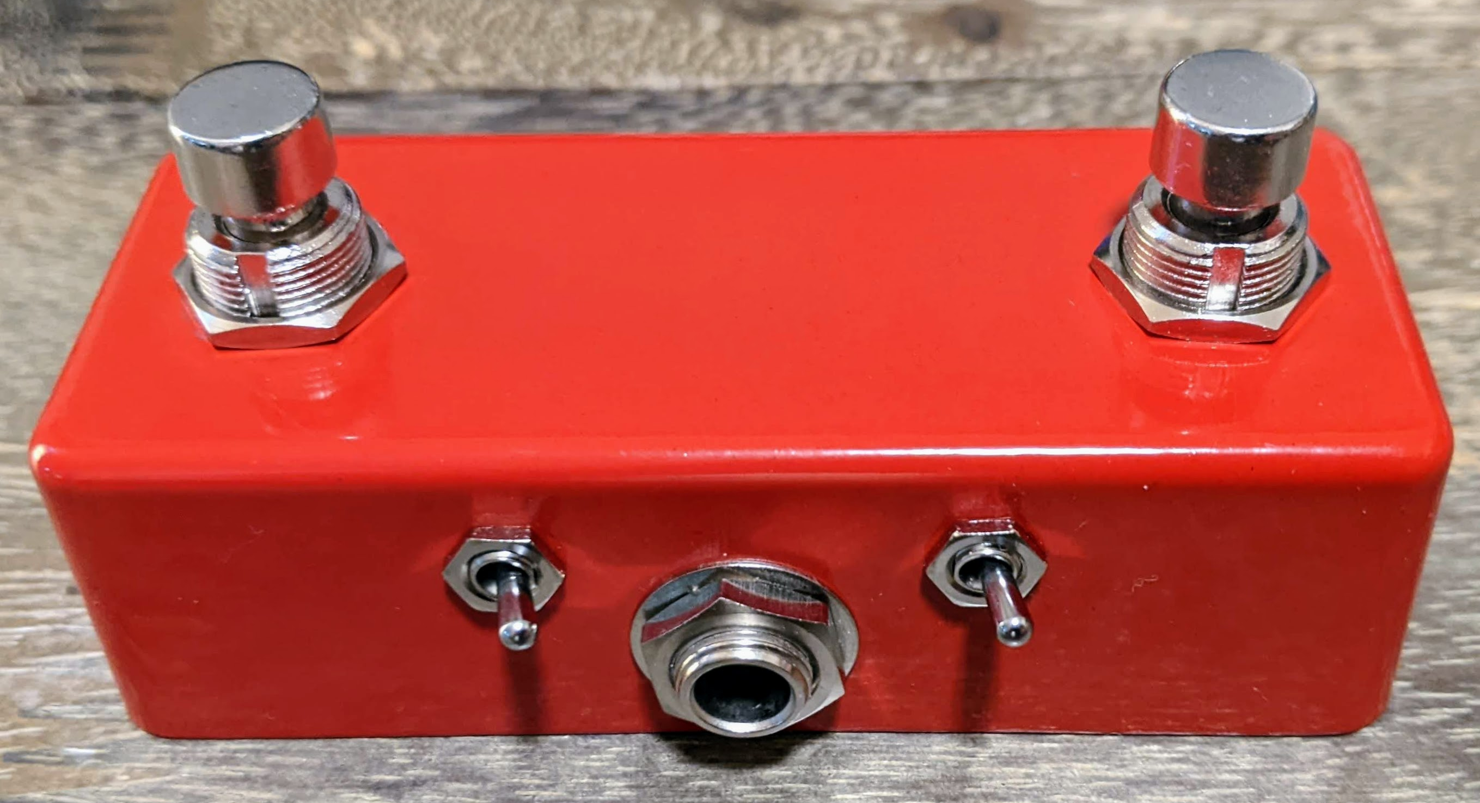
Looper Footswitch
Building a footswitch pedal with a very
small footprint to pair with a looper

Slide 8
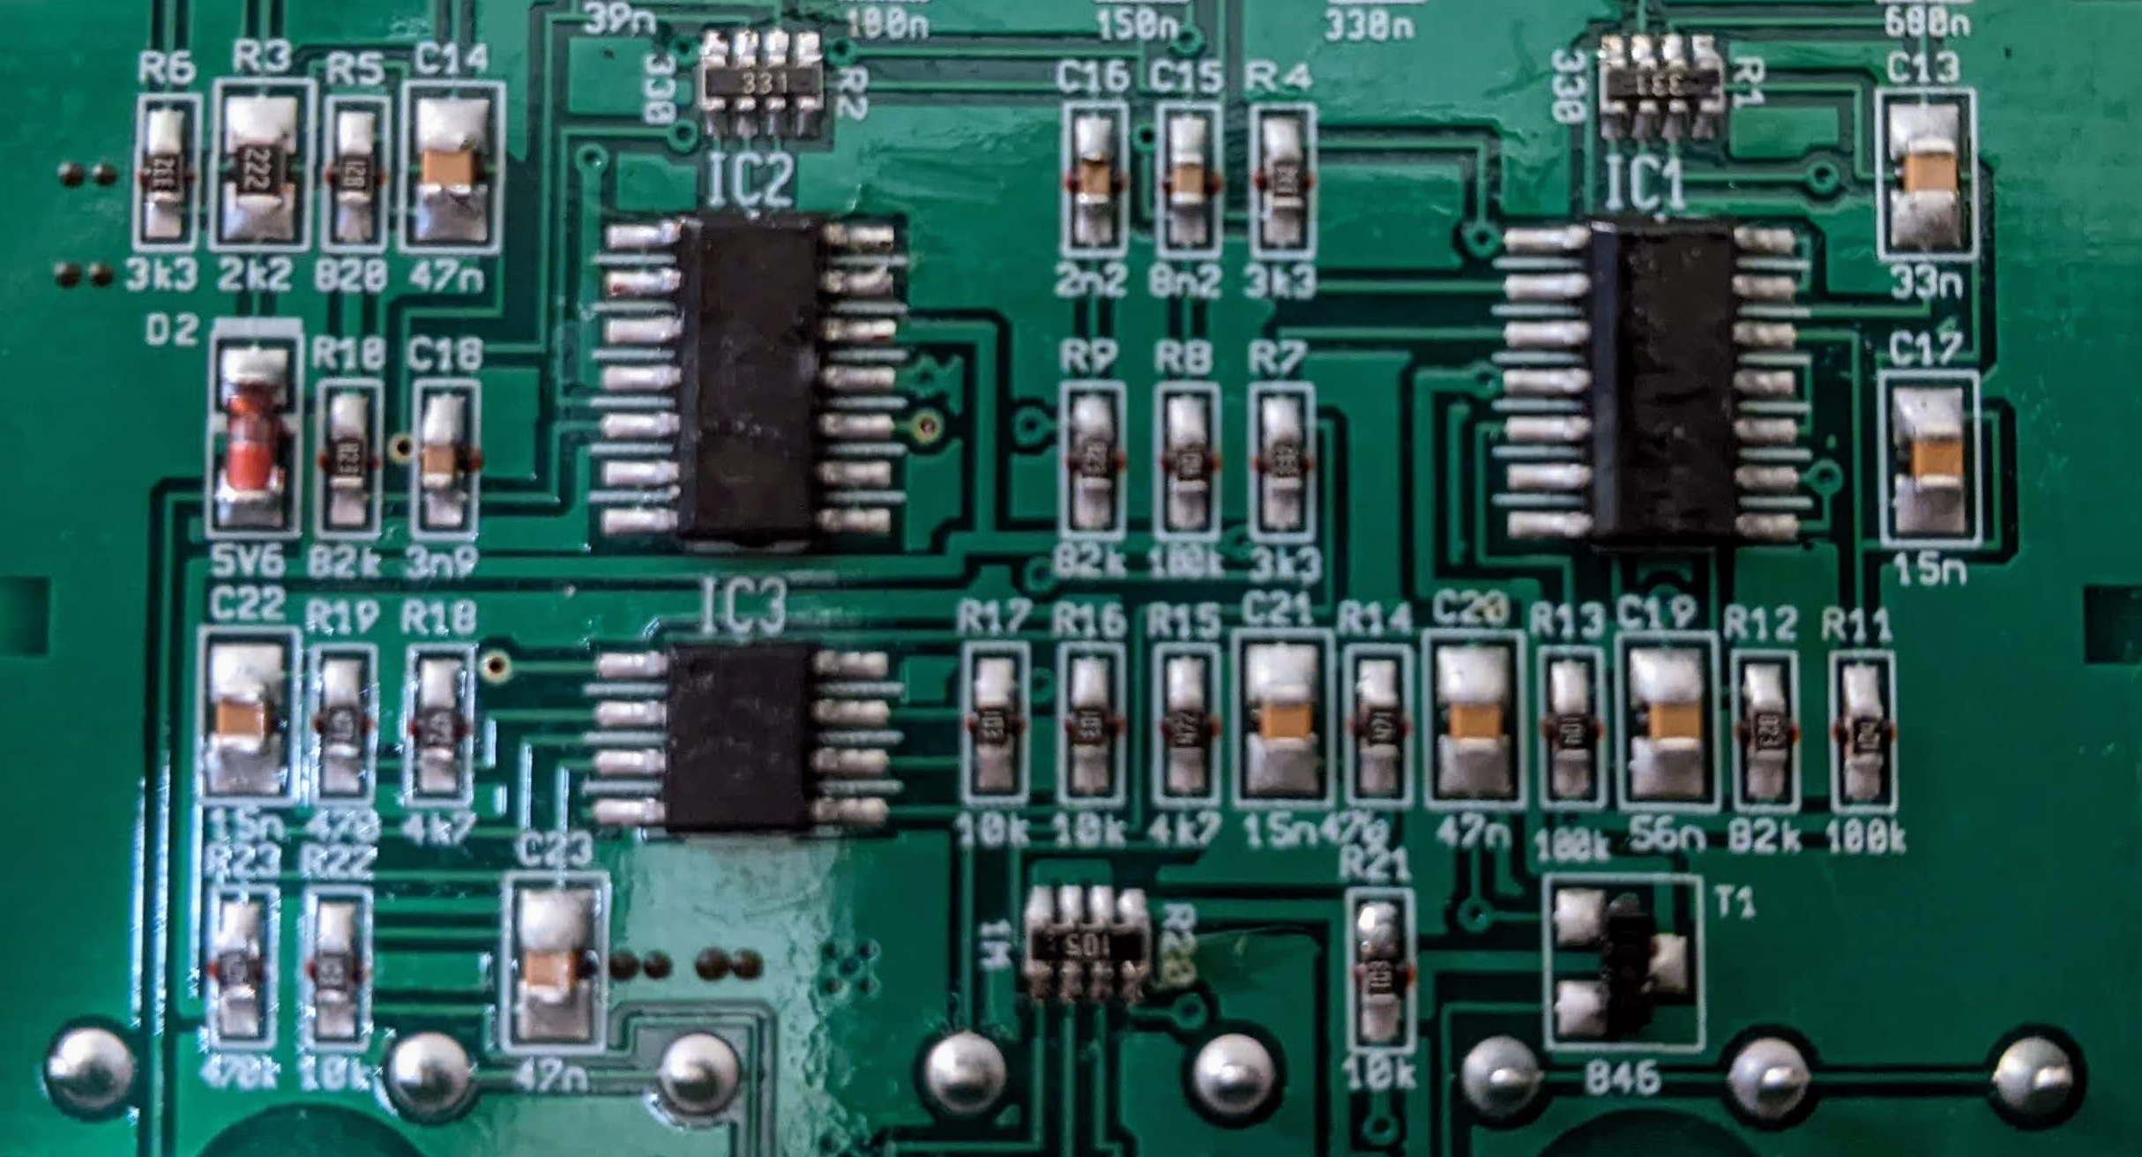
Modding an EQ700
Fixing a ground issue and further
modding a Behringer EQ700 Pedal

